Slide 1
Microservice Implementation On Cloud

Slide 2
What is Micro Services?
Micro services are an architectural approach to building applications . As an architectural framework, micro services are distributed and loosely coupled, so one team’s changes won’t break the entire app.
Features of microservice:
Highly maintainable and testable
Loosely coupled
Independently deployable
Organized around business capabilities
Owned by a small team

Slide 3
Prerequisites :-
Eclipse IDE with Slf4j, Aws DynamoDB and aws lambda maven dependencies.
AWS Console With Full IAM Role Secret Key And Access Key.
Advanced Rest Client for API Tester

Slide 4
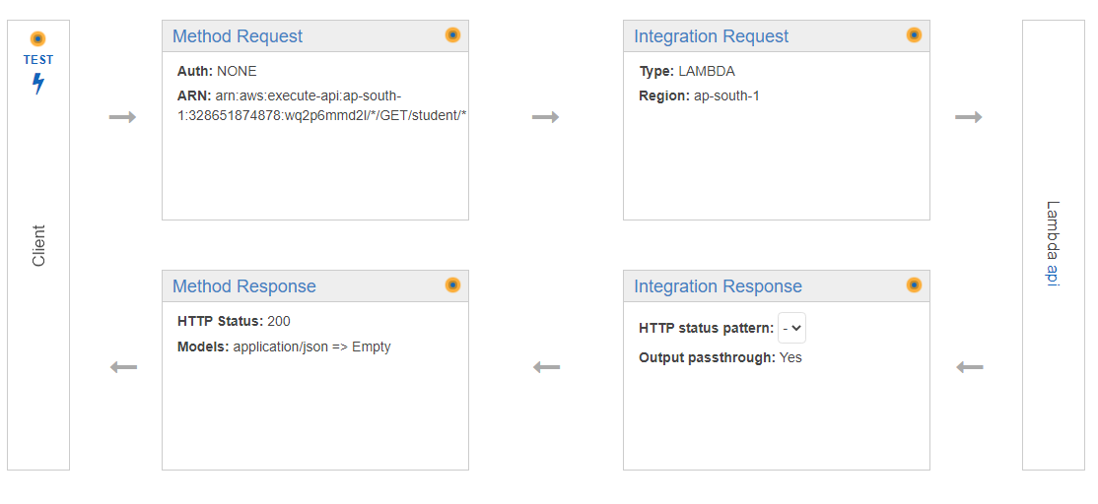
Architecture

Slide 5
Implementing Steps
Step 1:
Create One API Gateway in AWS Console and implement resources and methods.
Step 2:
Create Lambda Function and invoke to written source code.
Step 3 :
Connect lambda function to API Gateway.
Step 4:
Implement Integration request in both GET and POST methods.
Step 5:
Test endpoint URL using ARC .

Slide 6
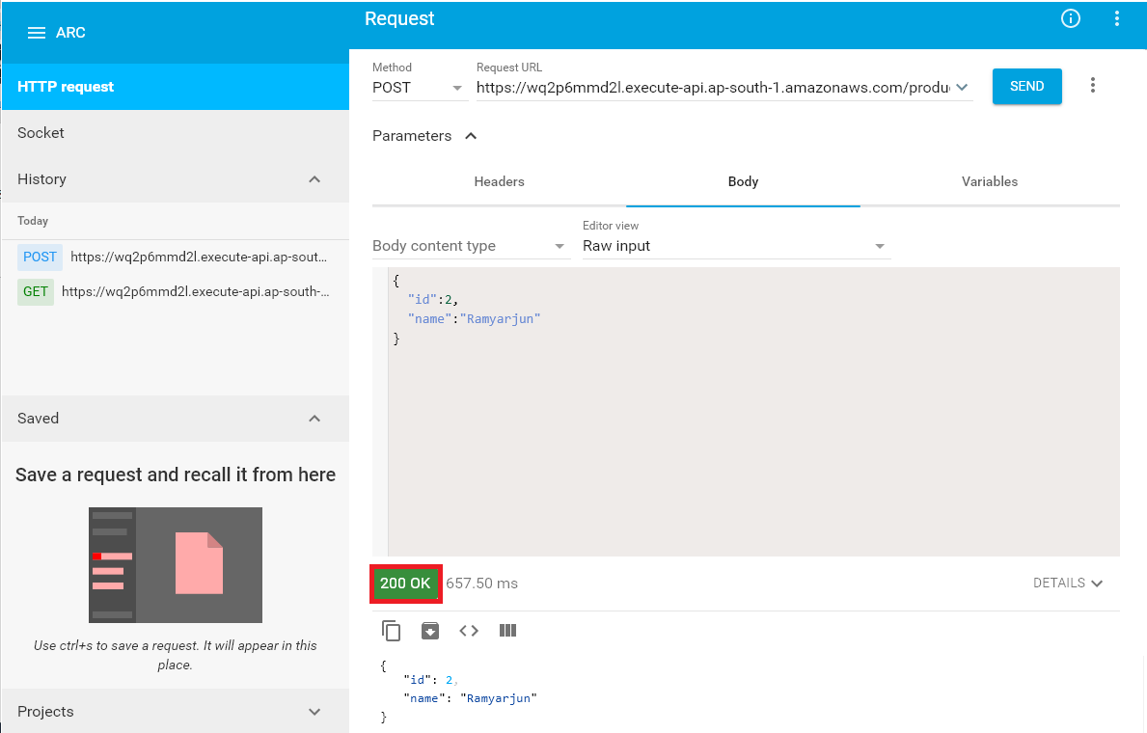
Output:
Getting end url test it using ARC and it gives status 200 ok.

